Slide 1

SAP Analytics cloud training
Anurag Bajaj
Extra – Planning Session

Slide 2

What is planning
Planning is a fundamental management function, which involves deciding before head,
what to be done,
when it will be done,
how it will be done and
who is going to do it.
It is an intellectual process which lays down an organization objectives to be able to achieve those goals. It chalks out specifically how to attain a specific goal. For example: how many new resources I need to hire in the same's department to touch 1bn sales.
Planning is performed for various functions of a company, such as sales planning, expense planning, core financial planning, reporting FY numbers through reports to shareholders of the company. HR plans for the people at all suggested levels (VP, SVP, Managers). Planning helps to increase coordination and onerous tasks that are distributed across multiple departments.
www.anubhavtrainings.com

Slide 3
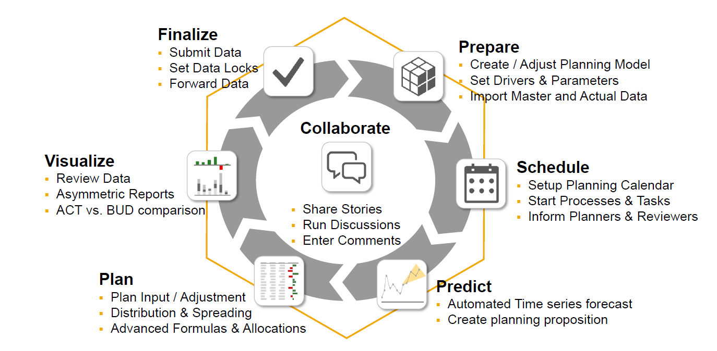
What is collaborative planning
www.anubhavtrainings.com

Slide 4
Planning Model – need to know
Planning data model includes versions (categories – Actuals, Forecast, Budget)
Actuals: Current facts data which is most recent or could be past experiences in reality. Transaction data.
Budget: Budgeting is the financial direction of where management wants min to be achieved, this is what will help qualifying the expectations of revenue that business expects. The budgeting number decides the bottom line of the company.
Forecast: tells whether the company is headed in right direction, estimating the amount of revenue and income that be achieved in future.
2. Planning models, will mandatorily have DATE/TIME Dimensions
3. We can also have organization dimension which represents the Business Entity (a plant, a subsidiary).
Regions → Country → States → Cities → Entity
www.anubhavtrainings.com

Slide 5
Planning model – Account Dimension
4. Account Dimension
In a planning model represents a business ledger account like operating expense, gross profit, net revenue. Most of these are calculated by other dimensions.
We will always can have a parent-child hierarchy in a/c dimension. This hierarchy is used to aggregate the numbers and calculate accounts based on hierarchy levels.
For each account dimensions we have contributions
EXP, INT – Expense – negative
INTINC, INC – Income -- positive
NFIN – Non Financials
5. We can apply currency conversion in finance data dependent on exchange rates
Average, Closing
www.anubhavtrainings.com

Slide 6
Create Planning Model – Hands on
Planning Model demo dataset <link>
1. Mark Properties and descriptions (later used for hierarchy creation)
2. Geo Enrich Data
3. Mark ENTITY, ACCOUNT, DATE and VERSION Dimensions
4. Data Wrangling
----Model created
1. Maintain model preference for FY, Data, Currency Conversion
----Model Hierarchies
1. Copy paste the account data properly
2. Create a story on planning model
www.anubhavtrainings.com

Slide 7
Create Model

Slide 8
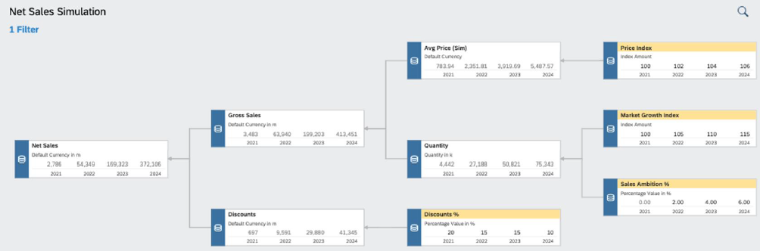
VDT
▪ Value driver trees (VDTs) allow visualizing the composition of a KPI and its contributing factors
▪ A VDT shows how a KPI is calculated from other KPIs and drivers
▪ In SAC, a value driver tree can be used to visualize existing data but also to simulate the impact of driver
changes in real time
▪ In planning, the VDT component can be used to create and simulate different scenarios
▪ Value driver trees are provided as standard story widgets and can be seamlessly integrated into SAC stories
www.anubhavtrainings.com

Slide 9
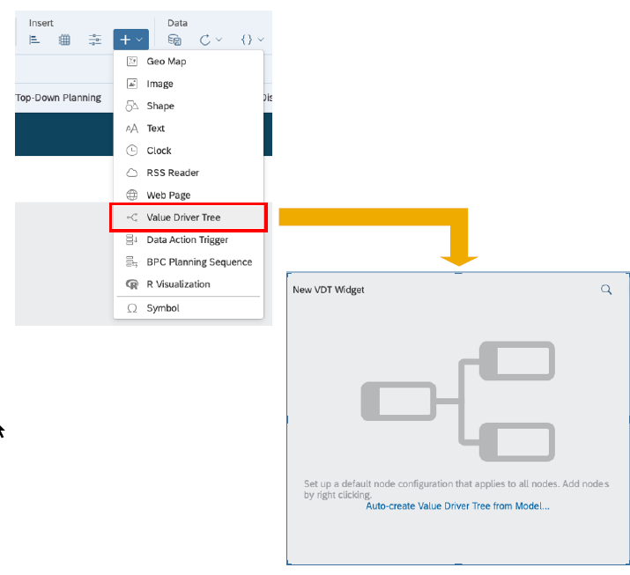
VDT
A value driver tree is a standard widget in the story
▪ VDT widgets can be configured like any other story widget by adding a new component and then using the builder panel
▪ A VDT is based on a data model. The nodes of the tree correspond to KPIs defined in the account dimension
▪ You can automatically generate a value driver tree from an existing model
▪ Alternatively, you can start building the tree from scratch, defining the nodes manually
www.anubhavtrainings.com

Slide 10
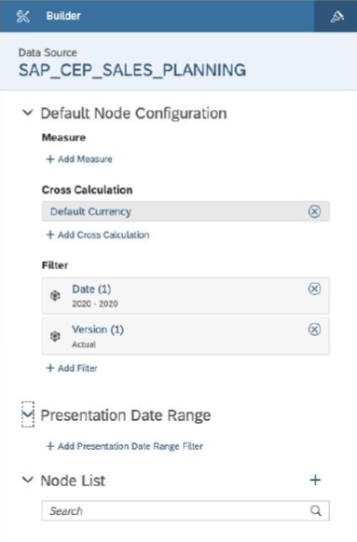
VDT – Node Config
A VDT is built by adding multiple nodes to the Node
List in the builder panel
▪ Each new node will inherit the default node configuration
▪ The configuration can be adjusted for each individual node
▪ The (visual) relation between the nodes is configured via parent/child properties of each node
▪ Parent/child nodes are other existing nodes from the node list
www.anubhavtrainings.com

Slide 11
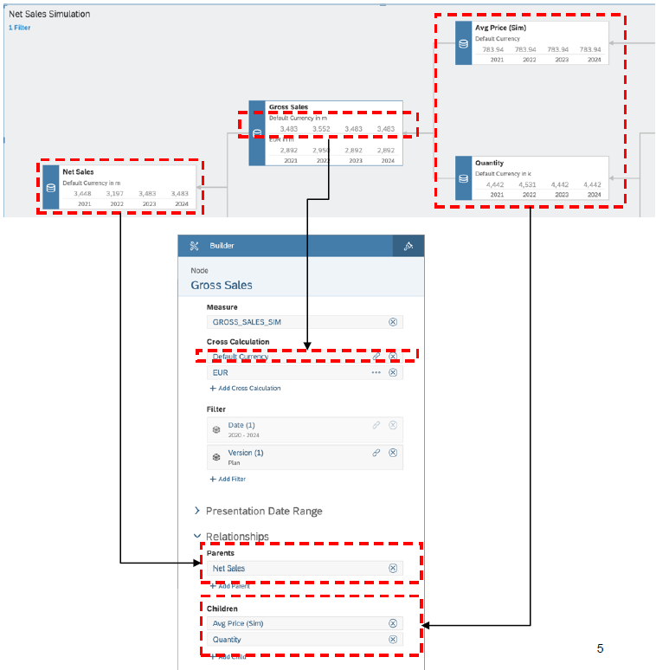
VDT
▪ For each node in the tree, the following parameters
can be configured:
− Measure: KPI to be shown (member of the
account dimension)
− Cross Calculation: Additional measures based
on the base KPI (e.g. different currencies)
− Filter: Scope definition for the KPI
− Presentation Date: Time horizon displayed in
the node
− Relationships: Parent and child nodes in the
tree
www.anubhavtrainings.com

Slide 12
Demo Scenario

Slide 13
End of Day

Slide 15

Questions

Slide 16

Anurag Bajaj
anurag.bajaj02@gmail.com

